Slide 1
Capstone Engagement
Assessment, Analysis, and Hardening of a Vulnerable System
By Colton Beaver

Slide 2
Table of Contents
This document contains the following sections:
01
Network Topology
02
Red Team: Security Assessment
03
Blue Team: Log Analysis and Attack Characterization
Hardening: Proposed Alarms and Mitigation Strategies
04

Slide 3
Network Topology
‹#›

Slide 4
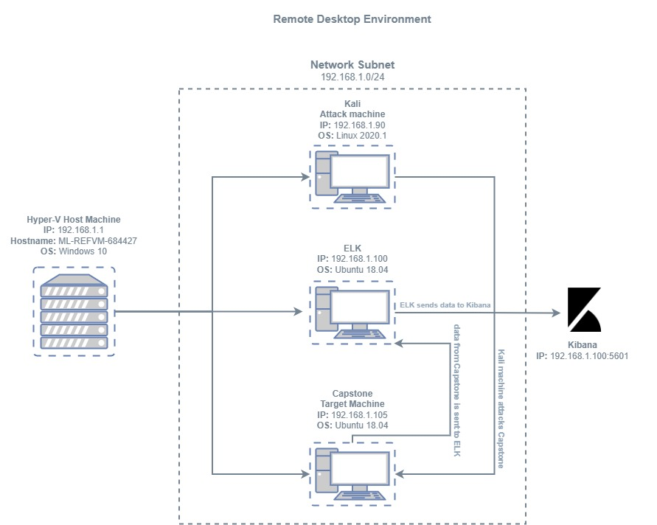
Network Topology
[Insert Here]
Use draw.io to create a diagram of the network.
Add your diagram to this slide and fill out the data in the sidebar.
Network
Address Range: 192.168.1.0/24
Netmask: 255.255.255.0
Gateway: 10.0.0.1
Machines
IPv4: 192.168.1.90
OS: Linux 2020.1
Hostname: Kali
IPv4: 192.168.1.100
OS: Ubuntu 18.04
Hostname: ELK
IPv4: 192.168.1.105
OS: Ubuntu 18.04
Hostname: Capstone
IPv4: 192.168.1.1
OS: Windows 10
Hostname: ML-REFVM-684427

Slide 5

Red Team
Security Assessment
‹#›

Slide 6
Recon: Describing the Target
Nmap identified the following hosts on the network:
Hostname | IP Address | Role on Network
ML-REFVM-684427 | 192.168.1.1 | Host Machine
Kali | 192.168.1.90 | Network Attack Machine
ELK | 192.168.1.100 | Data Monitoring Machine
Capstone | 192.168.1.105 | Target Machine

Slide 7
Vulnerability Assessment (Slide 1)
The assessment uncovered the following critical vulnerabilities in the target:
Vulnerability | Description | Impact
Directory Browsing | The directory listing is directly visible due to a lack of an index file. This can be considered a misconfiguration of the web server. | Allowing the directory listing to be directly visible leaves the web server vulnerable to critical information gathering by attackers who can map out the directory structure and use web vulnerability scanners to discover directories not directly linked in the listing.
Exposure of Sensitive Information to an Unauthorized Actor | Sensitive information is exposed to potential threat actors in several locations throughout the directory structure. | Potential threat actors can use the sensitive information gathered through these exposures to drill deeper into sensitive directories and gain advantages which could ultimately lead to the harm of the company.

Slide 8
Vulnerability Assessment (Slide 2)
The assessment uncovered the following critical vulnerabilities in the target:
Vulnerability | Description | Impact
Weak Password Requirements | Strong passwords are not required for user accounts which have access to sensitive directories. | Weak passwords requirements leave a system vulnerable to brute force attacks, allowing potential threat actors to compromise user accounts and use the privileges obtained from these accounts to further drill into the system.
Unrestricted Upload of File with Dangerous Type | Those who gain access to the WebDav directory are able to upload files of any type they wish, including malicious PHP script files. | A malicious payload could potentially be uploaded, then interpreted and executed as code. This could result in an attacker successfully establishing a persistent reverse shell backdoor to the web server.

Slide 9
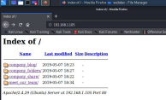
Exploitation: Directory Browsing
01
02
03
Tools & Processes
Open a web browser and search the IP 192.168.1.105/
DIRB was also able to be used for further recon with the following command: dirb http://192.168.1.105 /usr/share/wordlists/dirb/co mmon.txt
Achievements
The web browser gives access to the directory listing allowing us to browse files.
DIRB allowed us to locate http://192.168.1.105/webdav for future file injection
Screenshot:

Slide 10
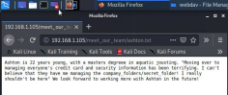
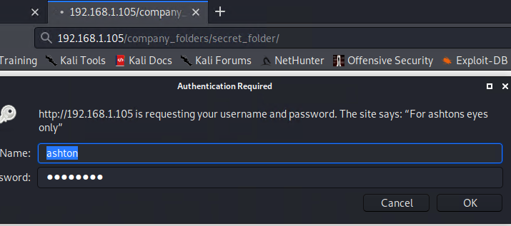
Exploitation: Exposure of Sensitive Information to an Unauthorized Actor
01
02
03
Tools & Processes
The web browser was used to investigate accessible information for anything that might lead to further exploitation.
Achievements
Two pieces of information were immediately available.
Those information are that there is a secret folder and the path to the folder is company_folders/secret_folder, as well as the fact that an employee named Ashton is responsible for this folder.
The information was found in 192.168.1.105/meet_our_team/ashton.txt
Screenshot

Slide 11
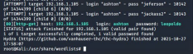
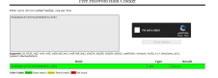
Exploitation: Weak Password Requirements
01
02
03
Tools & Processes
Hydra was used in conjunction with a rockyou txt file to crack ashtons password.
The following command was used to achieve this:
hydra -l ashton -P rockyou.txt -s 80 -f -vV 192.168.1.105
http-get
http://192.168.1.105/company_folders/secret_folder
Achievements
This brute force attack gave Ashtons password (leopoldo), resulting in access to the secret folder.
In the secret folder was a file with information on how to connect to the “corp server”. This included instructions to connect to webdav, and a hash for Ryans password. This hash was cracked with “Free Password Hash Cracker” to reveal the password of “linux4u”.
Screenshot:

Slide 12

Blue Team
Log Analysis and Attack Characterization
‹#›

Slide 13

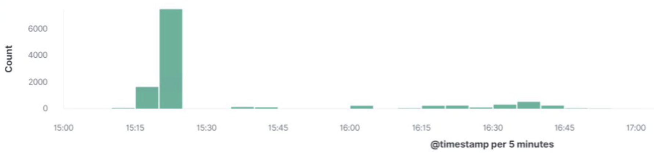
Analysis: Identifying the Port Scan
How many packets were sent, and from which IP?
What indicates that this was a port scan?
[Insert Here]
Include a screenshot of Kibana logs depicting the port scan.
11,238 packets were sent from 192.168.1.90 (the attack machine)
The sudden spike in traffic indicates that this is a port scan

Slide 14
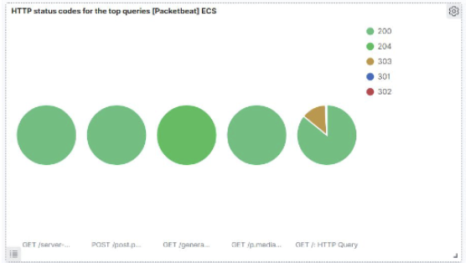
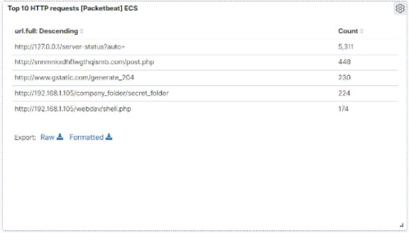
Analysis: Finding the Request for the Hidden Directory
What time did the request occur? How many requests were made?
Which files were requested? What did they contain?
[Insert Here]
Include a screenshot of Kibana logs depicting the request for the hidden directory.
224 requests were made to the hidden directory at 4PM.
The file that was requested was a _doc file. This file contained instructions on how to add and access the webdav network server

Slide 15
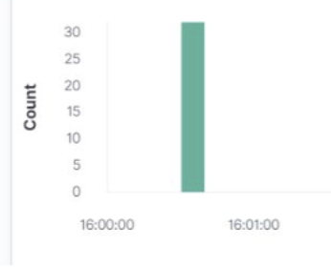
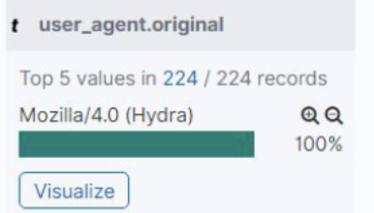
Analysis: Uncovering the Brute Force Attack
How many requests were made in the attack?
How many requests had been made before the attacker discovered the password?
[Insert Here]
Include a screenshot of Kibana logs depicting the brute force attack.
224 request were made during the brute force attack.
34 requests were made before the attacker discovered the password

Slide 16
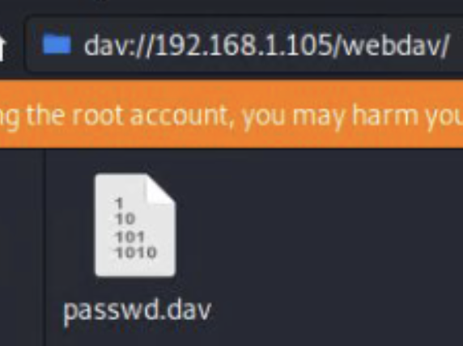
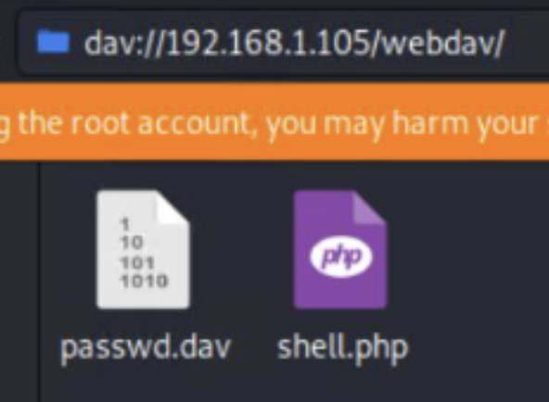
Analysis: Finding the WebDAV Connection
How many requests were made to this directory?
Which files were requested?
106 requests were made to the webdav directory
A password.dav file and a shell.php file.

Slide 17
Blue Team
Proposed Alarms and Mitigation Strategies
‹#›

Slide 18
Mitigation: Blocking the Port Scan
What kind of alarm can be set to detect future port scans?
Set an alarm that alerts a high number of port scan through a firewall.
What threshold would you set to activate this alarm?
An email should be sent to administrators when more then 10 port scans are done within a minute.
What configurations can be set on the host to mitigate port scans?
Only traffic from certain ports should be allowed; such as, port 80 and 443 to allow traffic from the internet.

Slide 19
Mitigation: Finding the Request for the Hidden Directory
What kind of alarm can be set to detect future unauthorized access?
Set an alarm that sends an email alert of higher than normal traffic and unauthorized IPs accessing the secret folder.
What threshold would you set to activate this alarm?
No more than 4 attempts to access the folder should be made.
What configuration can be set on the host to block unwanted access?
Only allow authorized IPs to have access to the secret folder as a whitelist. Also, encrypt any sensitive data and folders.
Describe the solution. If possible, provide required command lines.
/etc/httpd/conf/httpd.conf is where a whitelist can be made.

Slide 20
Mitigation: Preventing Brute Force Attacks
What kind of alarm can be set to detect future brute force attacks?
An alarm should be set to limit how many attempts can be made when entering a password before the user is locked out.
What threshold would you set to activate this alarm?
The threshold should be set very low to deter threat actors, for example, 5 attempts.
What configuration can be set on the host to block brute force attacks?
After 5 attempts, the user will be permanently locked out until and administrator can be contacted.
Describe the solution. If possible, provide the required command line(s).
Two factor authentication, complex passwords (8 or more characters, special characters, numbers and case sensitive) and changing passwords once a month would be additional ways to mitigate attacks.

Slide 21
Mitigation: Detecting the WebDAV Connection
What kind of alarm can be set to detect future access to this directory?
An alarm can be set to monitor traffic and connection attempts from unauthorized IPs to the webdav network.
What threshold would you set to activate this alarm?
The unauthorized user will only have 1 attempt.
What configuration can be set on the host to control access?
Blocking traffic from unauthorized IPs with a whitelist or group policy.
Describe the solution. If possible, provide the required command line(s).
Also, more complex passwords (8 or more characters, special characters, numbers and case sensitive) should be implemented to avoid brute force attacks.

Slide 22
Mitigation: Identifying Reverse Shell Uploads
What kind of alarm can be set to detect future file uploads?
Create an alarm to alert when a file is being upload to the webdav folder, whether it is malicious or not. Another alarm should be made when port 4444 is being connected to.
What threshold would you set to activate this alarm?
Alerts should be immediate!
What configuration can be set on the host to block file uploads?
Access to the webdav folder should be set to “read only”. Also, only authorized IPs should have access to the webdav folder.

